Slide 1
Windows, Frames, Alerts Handling
2025
Poornima

Slide 2
Handling Radiobutton
To find and interact with a radio button element in Selenium (Java), you can use any suitable locator (id, name, xpath, etc.) just like other elements.
✅ 2. Directly Using By.xpath
driver.findElement(By.xpath("//input[@name='gender' and @value='male']")).click();
Basic HTML for Radio Buttons
<input type="radio" name="gender" value="male"> Male<br>
<input type="radio" name="gender" value="female"> Female<br>
✅ 3. Check if Radio Button is Selected
WebElement radioMale = driver.findElement(By.xpath("//input[@value='male']"));
System.out.println("Is Male selected? " + radioMale.isSelected());
✅ 4. Check if Radio Button is Enabled/Displayed
if (radioMale.isEnabled() && radioMale.isDisplayed()) {
radioMale.click();
}
✅ 1. Find and Click a Radio Button in Selenium (Java)
🔹 Using By.name and value:
List radioButtons = driver.findElements(By.name("gender"));
for (WebElement radio : radioButtons) {
if (radio.getAttribute("value").equals("female")) {
radio.click();
break;
}
}

Slide 3
Handling Checkbox
Checkboxes are used for multi-select options, and Selenium provides methods to handle them like click, verify selection, and conditionally select/deselect.
1️⃣ Locate the Checkbox
WebElement checkbox = driver.findElement(By.id("subscribeCheckbox"));
2️⃣ Select the Checkbox (if not already selected)
if (!checkbox.isSelected()) {
checkbox.click();
}
3️⃣ Deselect the Checkbox (if selected)
if (checkbox.isSelected()) {
checkbox.click();
}
4️⃣ Check Checkbox State
boolean isChecked = checkbox.isSelected();
System.out.println("Checkbox selected: " + isChecked);
🔄 Handling Multiple Checkboxes
If checkboxes have a common attribute (e.g., name='skills'):
List checkboxes = driver.findElements(By.name("skills"));
for (WebElement box : checkboxes) {
if (box.getAttribute("value").equals("Java")) {
if (!box.isSelected()) {
box.click();
}
}
}

Slide 4
Handling Dropdown
select an option in a dropdown using Selenium, you typically use the Select class provided by Selenium for <select> HTML elements.
Here’s a step-by-step guide with examples in Java:
✅ 1. Import the Select class
import org.openqa.selenium.support.ui.Select;
✅ 2. Locate the Dropdown Element
Use any locating strategy like By.id, By.name, By.xpath, etc.
WebElement dropdown = driver.findElement(By.id("dropdownId"));
✅ 3. Create Select Object
Select select = new Select(dropdown);
✅ 4. Select Options Using One of These Methods:
➤ a. By Visible Text:
select.selectByVisibleText("OptionText");
➤ b. By Value Attribute:
select.selectByValue("optionValue");
➤ c. By Index:
select.selectByIndex(2); // Index starts from 0

Slide 5
Handling Dropdown
✅ 5. Get All Options in Dropdown
List<WebElement> allOptions = select.getOptions();
for (WebElement option : allOptions) {
System.out.println(option.getText());
}
✅ 6. Get Selected Option
WebElement selectedOption = select.getFirstSelectedOption();
System.out.println("Selected option: " + selectedOption.getText());
To handle dropdowns without using the Select class, you typically interact with custom-styled dropdowns (not based on <select> tags). These are often built using <div>, <ul>, or <span> elements.
✅ Key Points:
Always ensure the dropdown is visible before locating options.
Use explicit waits if needed to wait for options to appear.
Example with WebDriverWait:
WebDriverWait wait = new WebDriverWait(driver, Duration.ofSeconds(10));
wait.until(ExpectedConditions.visibilityOfElementLocated(By.xpath("//ul[@class='dropdown-menu']/li")));

Slide 6
Handling Dropdown
Example: Handle Custom Dropdown in Selenium (Java)
HTML structure (example):
<div class="dropdown">
<button id="dropdownButton">Select Option</button>
<ul class="dropdown-menu">
<li>Option 1</li>
<li>Option 2</li>
<li>Option 3</li>
</ul>
</div>
Java Selenium Code (No Select class):
// 1. Click to open the dropdown
driver.findElement(By.id("dropdownButton")).click();
// 2. Get list of options
List<WebElement> options = driver.findElements(By.xpath("//ul[@class='dropdown-menu']/li"));
// 3. Loop and select the desired option
for (WebElement option : options) {
if (option.getText().equals("Option 2"))
{
option.click();
break;
}
}

Slide 7
Handling Multiple windows, tabs
In Selenium, handling multiple windows (or tabs) is crucial when your automation flow involves pop-ups, new windows, or tab navigation. Selenium provides ways to manage and switch between these windows using window handles.
✅ Key Concepts
Window Handle: A unique identifier (String) assigned to each browser window opened by WebDriver.
Driver.getWindowHandle(): Returns the handle of the current window.
Driver.getWindowHandles(): Returns a Set of all window handles opened.
Driver.switchTo().window(handle): Switches control to the specified window.
🔁 Step-by-Step: Switching Between Windows
1. Get the current (parent) window handle.
2. Trigger the action that opens a new window/tab.
3. Get all window handles.
4. Loop through the handles and switch to the one that is not the current.
5. Perform your actions in the new window.
6. Optionally switch back to the original window.

Slide 8
Handling Multiple windows, tabs
Example Code:
// Perform operations in the new window
System.out.println("Title of new window: " + driver.getTitle());
// Close the new window
driver.close();
// Switch back to main window
driver.switchTo().window(mainWindowHandle);
// Store the main window handle
String mainWindowHandle = driver.getWindowHandle();
// Click on a link/button that opens a new window
driver.findElement(By.linkText("Open New Window")).click();
// Get all window handles
Set<String> allWindowHandles = driver.getWindowHandles();
// Switch to the new window
for (String handle : allWindowHandles) {
if (!handle.equals(mainWindowHandle)) {
driver.switchTo().window(handle);
break;
}
}
List<String> for index-based access
List<String> handlesList = new ArrayList<>(allHandles);
// Switch to 2nd window
driver.switchTo().window(handlesList.get(1));
System.out.println("Title of 2nd window: " + driver.getTitle());

Slide 9
Handling Multiple windows, tabs
When a link opens in a new tab (instead of a popup window), Selenium handles it just like multiple windows, using window handles.
There’s no separate tab-specific API in Selenium — tabs are just additional browser windows under the hood.
✅ Step-by-Step: Switch Between Tabs
Store the current tab/window handle
Perform an action that opens a new tab
Get all window handles
Switch to the new tab
Perform actions
Close tab or switch back

Slide 10
Handling Multiple windows, tabs
🔧 Example Code
// 1. Store the current (main) tab
String mainTab = driver.getWindowHandle();
// 2. Click a link that opens in a new tab
driver.findElement(By.linkText("Open New Tab")).click();
// 3. Get all window handles
Set<String> allTabs = driver.getWindowHandles();
// 4. Switch to the new tab
for (String tab : allTabs) {
if (!tab.equals(mainTab)) {
driver.switchTo().window(tab);
break;
}
}
// 5. Perform actions in the new tab
System.out.println("Title of new tab: " + driver.getTitle());
// 6. Close new tab
driver.close();
// 7. Switch back to main tab
driver.switchTo().window(mainTab);

Slide 11
Handling Frames
Handling frames and iframes in Selenium is essential when working with web pages that embed content from other sources or isolate parts of the page into separate HTML documents.
🔍 What is an iframe?
An iframe (inline frame) is an HTML element used to embed another document within the current page.
Selenium cannot interact with elements inside an iframe unless it switches into the frame context.
✅ How to Handle Frames/iFrames in Selenium
🔁 3 Ways to Switch to a Frame:
By Index
driver.switchTo().frame(0); // Switches to first frame on the page
By Name or ID
driver.switchTo().frame("frameName");
By WebElement
WebElement frameElement = driver.findElement(By.xpath("//iframe[@id='loginIframe']"));
driver.switchTo().frame(frameElement);

Slide 12
Handling Frames
⏪ Switch Back to Main Page
driver.switchTo().defaultContent(); // Returns to the main page
driver.switchTo().parentFrame(); // Goes one level up
✅ Example:
// Switch to iframe by WebElement
WebElement iframe = driver.findElement(By.id("iframeID"));
driver.switchTo().frame(iframe);
// Perform actions inside the iframe
driver.findElement(By.id("username")).sendKeys("admin");
// Switch back to main content
driver.switchTo().defaultContent();
Issue | Solution
ElementNotInteractableException | Ensure you're in the correct frame
NoSuchElementException | Double-check frame name/index/locator
Multiple nested iframes | Use multiple switchTo().frame() calls

Slide 13
Handling Alerts
In web automation, JavaScript alerts (also called popups) are common for warnings, confirmations, or input prompts. Selenium handles them using the Alert interface.
Types of JavaScript Alerts:
Simple Alert – Displays a message and an OK button
Confirmation Alert – Displays OK and Cancel buttons
Prompt Alert – Accepts text input, then OK/Cancel
3. Confirmation Alert
Alert alert = driver.switchTo().alert();
alert.dismiss(); // click Cancel
// or
alert.accept(); // click OK
4. Prompt Alert (Text Input)
Alert alert = driver.switchTo().alert();
alert.sendKeys("Test Input"); // type into prompt
alert.accept(); // click OK
Switch to Alert
Alert alert = driver.switchTo().alert();
2. Simple Alert
Alert alert = driver.switchTo().alert();
System.out.println(alert.getText()); // read alert message
alert.accept(); // click OK

Slide 14
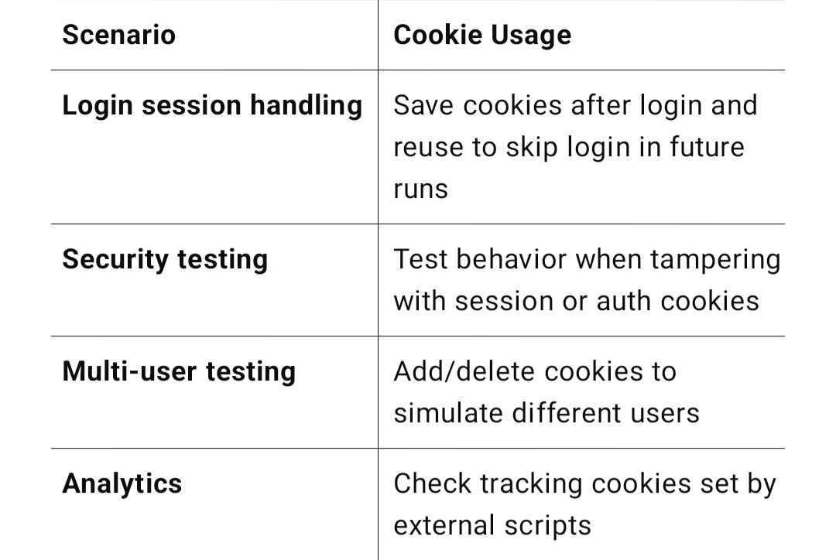
Handling Cookies
Cookies are small pieces of data stored by the browser to maintain user sessions, preferences, and tracking information. Selenium allows you to add, retrieve, and delete cookies during your automation tests.
✅ Common Cookie Operations in Selenium
Selenium provides the Options interface to manage cookies:
driver.manage().getCookies(); // returns all cookies
driver.manage().getCookieNamed("cookieName"); // gets a specific cookie
driver.manage().addCookie(cookie); // adds a cookie
driver.manage().deleteCookie(cookie); // deletes specific cookie
driver.manage().deleteCookieNamed("cookieName"); // deletes by name
driver.manage().deleteAllCookies(); // deletes all cookies

Slide 15
Handling Cookies
Example: Add, Get, and Delete Cookies
// Open a website
driver.get("https://example.com");
// Add a new cookie
Cookie cookie = new Cookie("userSession", "abc123");
driver.manage().addCookie(cookie);
// Retrieve a cookie by name
Cookie sessionCookie = driver.manage().getCookieNamed("userSession");
System.out.println("Cookie Name: " + sessionCookie.getName());
System.out.println("Cookie Value: " + sessionCookie.getValue());
// Get all cookies
Set<Cookie> allCookies = driver.manage().getCookies();
for (Cookie c : allCookies) {
System.out.println(c.getName() + " = " + c.getValue());
}
// Delete a specific cookie
driver.manage().deleteCookieNamed("userSession");
// Delete all cookies
driver.manage().deleteAllCookies();

Slide 16
Handling Cookies
🔁 Example: Reusing Login Cookie to Avoid Login Every Time
// After login
Cookie loginCookie = driver.manage().getCookieNamed("session_id");
// Store it (e.g., in a file or memory), then reuse in next session:
driver.get("https://example.com");
driver.manage().addCookie(loginCookie);
driver.navigate().refresh(); // You’ll be logged in

Slide 17
Handling Cookies
Why Handle Cookies in Selenium?
Login persistence: Store cookies to avoid repeated logins during tests.
Session management: Validate session expiration or renewal.
Security testing: Check how applications handle cookie manipulation.
Performance: Speed up tests by skipping repetitive authentication steps.

